Slide 1
Orientation Advising 2023 Physics & Astronomy
Academic Advisors:
Olivia Biehle olivia.biehle@austin.utexas.edu
Nathaniel Sulapas nathaniel.sulapas@austin.utexas.edu
Jennifer McHam jennifer.mcham@austin.utexas.edu

Slide 2
Fall Semester Courses​ Sample Schedule​s Will vary depending on assigned CNS Community​
M 408C - Calculus
PHY 110C – Seminar for PHY majors
UGS 302 or 303 – Core requirement
CH 301 or AST 307 – Major requirement
RHE 306 or other core (ex. MUS 307)

Slide 3
Physics Majors
M 408D
PHY 301 & 101L
PHY 110C
UGS 302 or 303
RHE 306 or other core course
For students who have credit for M 408C or M 408N (K) & S (L)
M 408M or M 427L-AP
PHY 316 & 116L
PHY 110C
UGS 302 or 303
RHE 306 or other core course
For students who have a 5 on Calculus BC and credit for PHY 301 & 101L

Slide 4
Astronomy Majors
M 408D
PHY 301 & 101L
AST 307
UGS 302 or 303
For students who have credit for M 408C or M 408N (K) & S (L)
For students who have a 5 on Calculus BC and credit for PHY 301 & 101L
M 408M or M 427L-AP
PHY 316 & 116L
AST 307
UGS 302 or 303

Slide 5
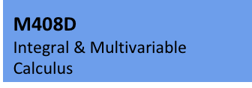
Mathematics Course Sequences
Physics and Astronomy degrees require M 408C & M 408D
or M 408N (aka K), M 408S (aka L), and M 408M
M 427L-AP can count in place of M 408M or M 408D

Slide 6
Consider the Following Things When Choosing Fall Mathematics Course
Your choice is based on:
1) Your UTMA score
70 or higher for M 408C or M 408N (78 recommended for M 408C)
(55 or higher for M 305G)

Slide 7
2) AP Credit
Score | Credit Earned | Fall Course Recommendation
AB: 3 or 4 | M 408N (K) | M 408N or M 408C or M 408S
AB: 5 | M 408C | M 408D or M 408D-AP
BC: 3 or 4 | M 408C | M 408C or M 408D or M 408D-AP
BC: 5 | M 408C or M 408N (K) & 408S (L) | M 408D or M 408M or M 427L-AP
(M 408N and M 408S are the College of Natural Sciences versions of M 408K & M 408L)
3) Dual Credit
M 408N ➡️ M 408S M 408N & 408S ➡️ M 408M
4) Confidence in your math skills

Slide 8
Other Factors to Consider
(If you are eligible for calculus but close to the cut-off score of 70):
No high school calculus
You took calculus, but not AP, in high school
Your gut says you are not prepared for college calculus
Preparation for Calculus (M 305G) is an option

Slide 9
If you decide to take calculus:
Use the Math Readiness Package this summer
Go to discussion sections in fall
Make use of resources
Sanger Learning Center
CalcLab
Professor's office hours
Talk to an advisor if you are not sure which math course to take

Slide 10
Advanced Math
If you took math beyond the level of AP Calculus BC in high school, the Academic Advisor you meet with will refer you to the Math Faculty Advisor.

Slide 11
Physics Courses
PHY 110C – Science of the Times seminar
Often the only PHY course in 1st semester
PHY 301 & PHY 101L – Mechanics & lab
Prerequisite: credit with at least C- or registration in M 408D, 408L, or 408S and PHY 101L
PHY 316 & 116L – Electricity and Magnetism & lab
Prerequisite: PHY 301 & 101L with at least C- in each; credit with at least C- or registration in M 408D or 408M, and PHY 116L

Slide 12
Other Science Courses
BS in Physics requires CH 301 & 302 plus 6 hrs majors-level coursework in BIO, GEO, or AST (Biophysics requires BIO 311C & 311D)
BSA in Physics requires 3 hrs majors-level coursework in AST, BIO, CH, CS, and GEO (can overlap with core Science & Tech Part II)
BS in Astronomy requires AST 307; requires 6 hrs majors-level coursework in BIO, CH, CS, and/or GEO (Elements of Computing courses may be counted)
BSA in Astronomy requires 12 hrs majors-level coursework from 1 or more of these areas: BIO, CH, CS, GEO, Mathematics, SDS

Slide 13
Science Courses & AP Scores
AP Chemistry, 4-5 | Chemistry – CH 301, 302 & 204
AP Physics 1, 3-5 (PHY/AST Majors should not claim this credit!) | Physics (algebra-based) – PHY 302K & 105M
AP Physics 2, 3-5. (PHY/AST Majors should not claim this credit!) | Physics (algebra-based) – PHY 302L & 105N
AP Physics C-Mechanics, 3-5 | Physics (calculus-based) - PHY 301 & 101L (or PHY 303K & 105M)
AP Physics C-Elect. & Magnetism, 3-5 | Physics (calculus-based) - PHY 316 & 116L (or PHY 303L & 105N)
AP Biology, 3-4; AP Biology 5 | Biology – BIO 311C; BIO 311C & 311D

Slide 14
UGS 302 or 303: Signature Course
Topic based
302 - writing based, small
303 - larger, less writing
Must take in first 2 semesters
Have several back up topics in mind!

Slide 15
Core Courses & AP Credit https://ugs.utexas.edu/core/requirements/current (Talk to your Academic Advisor before claiming credit)
RHE 306 – Composition 1 | AP Language, 3-5 or SAT Writing & Lang, 33+
E 316L, M, N, or P - Literature | AP Literature, 4-5
US History, 6 hrs | AP US History, 3-5: HIS 315L
Government, 6 hrs | AP Government, 3-5: GOV 310L
Social & Behavioral Science, 3 hrs | AP PSY, ECO, GRG, 3-5
Visual & Performing Arts, 3 hrs | AP Art History or Music Theory, 3-5

Slide 16
Course Flags Courses with content that fulfill core curriculum skills & competencies
6 Flag types: Writing – need 2 total, 1 upper-division (one cannot overlap with a core course)
Quantitative Reasoning – built in
Independent Inquiry
Global Cultures – UGS 302/303, History courses, VAPAs, Literature, electives
Cultural Diversity – UGS 302/3, History courses, VAPAs, electives
Ethics – UGS 302/3, Government, Business minor courses, electives

Slide 17
CNS Cornerstones Communities
Most common:
FIG – First-Year Interest Group
Includes UGS 018 – Seminar (not a study group)
Course(s) taken by all FIG members
Add "98" number first when you register
Group of about 20-25 that meets weekly with an Advisor and a Student Mentor
Get to know other people with similar interests
Share 1 or more courses – reserved seats
Informal meeting with a professor, help with registration, study skills information, fun, etc.
Free food

Slide 18
Other Courses That May Be Part Of Your Schedule
FRI (Research Methods Course)
UTeach (UTS 101)
Foreign Language or Foreign Culture courses (B.S. degrees)
Special programs may require certain courses (Jefferson Scholars, University Leadership Network, Plan II, etc.)

Slide 19
Possible Interest in Teaching?
See Orientation Schedule for several UTeach info sessions and events
Check out UTeach Palooza on Day 2, 2-3:30 PM on the Painter front lawn
Visit uteach.utexas.edu for other UTeach information

Slide 20
Minors & Certificates
Required only for BSA degrees
Optional for other degrees
Another option for a BSA degree is 15 hrs in a single subject
Transcripted minor or certificate: specific guidelines & classes
Claiming a minor or certificate does not guarantee access to all classes that can count
https://cns.utexas.edu/students/degrees-majors-advising/transcripted-certificates
https://cns.utexas.edu/students/degrees-majors-advising/transcripted-minors

Slide 21
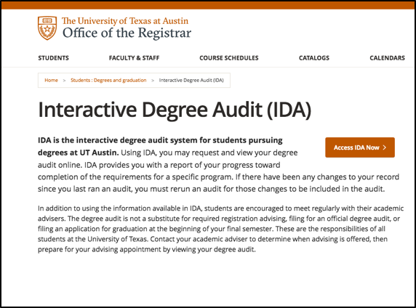
Interactive Degree Audit
Excellent way to see how courses count and what requirements you still have

Slide 22
Registration
Before Registration
Be thinking about which math & science courses you want to take
Have a 1-on-1 meeting with an Academic Advisor (Day 2)
Advisor will provide information about reserved course(s) in your CNS community
Choose 2-3 more courses (for many, UGS 302 or 303 should be one of these)
Have back-up courses in mind
Check your Registration Information Sheet (RIS) for bars
Registration on Day 3
Academic Advisors will be available by email; phone or Zoom as needed
Follow Advisor’s instructions about adding reserved courses first

Slide 23
Registration can be stressful,
but remember:
We are here to help
You will get what you need (not always exactly what you want)
Things change, especially in August:
Use wait lists when you can
Make changes during add & drop periods in August & Sept.
It's the beginning of your UT adventure!

