Slide 1
Orientation Advising 2023 Mathematics
Academic Advisors:
Olivia Biehle olivia.biehle@austin.utexas.edu
Nathaniel Sulapas nathaniel.sulapas@austin.utexas.edu
Jennifer McHam jennifer.mcham@austin.utexas.edu

Slide 2
Fall Semester Courses​ Sample Schedule​ Will vary depending on assigned CNS Community​
Math course
UGS 302 or 303 – core requirement
Science (ex: CH 301) or Technology course (ex: CS 303E)
RHE 306 or other core course (ex: MUS 307) - (Actuarial students may want to take ECO 304K, a Social & Behavioral Science)

Slide 3
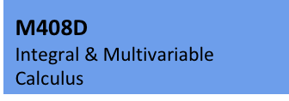
Mathematics Course Sequences
Most Math degrees require M 408C & M 408D or M 408N (aka K) and M 408S (aka L);
The BSA requires M 408C & M 408D or M 408N, M 408S, and M 408M (although M 408M can be waived); M 408M is an option for the BS: Option VII, Mathematics degree

Slide 4
Consider the Following Things When Choosing Fall Mathematics Course
Your choice is based on:
1) Your UTMA score
70 or higher for M 408C or M 408N (78 recommended for M 408C)
(55 or higher for M 305G – Preparation for Calculus)

Slide 5
2) AP Credit
Score | Credit Earned | Fall Course Recommendation
AB: 3 or 4 | M 408N (K) | M 408N or M 408C or M 408S
AB: 5 | M 408C | M 408D or M 408D-AP
BC: 3 or 4 | M 408C | M 408C or M 408D or M 408D-AP
BC: 5 | M 408C or M 408N (K) & 408S (L) | M 408D or M 427L-AP
(M 408N and M 408S are the College of Natural Sciences versions of M 408K & M 408L)
3) Dual Credit
M 408N ➡️ M 408S M 408N & 408S ➡️ Consult with Advisor for options
4) Confidence in your math skills

Slide 6
Other Factors to Consider
(If you are eligible for calculus but close to the cut-off score of 70):
No high school calculus
You took calculus, but not AP, in high school
Your gut says you are not prepared for college calculus
Preparation for Calculus (M 305G) is an option

Slide 7
If you decide to take calculus:
Use the Math Readiness Package this summer
Go to discussion sections in fall
Make use of resources
Sanger Learning Center
CalcLab
Professor's office hours
Talk to an advisor if you are not sure which math course to take

Slide 8
Advanced Math
If you took math beyond the level of AP Calculus BC in high school, the Academic Advisor you meet with will refer you to the Math Faculty Advisor.

Slide 9
Science Courses
BS in Math: 8 hours in one area selected from AST, BIO, CH, GEO, or PHY
BSA: 6 hours in one area selected from AST, BIO, CH, GEO, MNS, or PHY and 3 hours from another area selected from AST, BIO, CH, CS, GEO, MNS, or PHY
Important: must be majors-level courses
Can overlap with the core science requirement
CS 303E is required for a BS in Math and will count toward Science & Tech II
CH and PHY are the best options for the 6-hour or 8-hour requirement

Slide 10
Science Credit & AP Scores
AP Chemistry, 4-5 | Chemistry – CH 301, 302 & 204
AP Physics 1, 3-5 | Physics (algebra-based) – PHY 302K & 105M
AP Physics 2, 3-5 | Physics (algebra-based) – PHY 302L & 105N
AP Physics C-Mechanics, 3-5 | Physics (calculus-based) - PHY 303K & 105M or PHY 301 & 101L
AP Physics C-Elect. & Magnetism, 3-5 | Physics (calculus-based) - PHY 303L & 105N or PHY 316 & 116L
AP Biology, 3-4; AP Biology 5 | Biology – BIO 311C; BIO 311C & 311D

Slide 11
UGS 302 or 303: Signature Course
Topic-based
302 - writing based, small
303 - larger, less writing
Must take in first 2 semesters
Have several back up topics in mind!

Slide 12
Core Courses & AP Credit https://ugs.utexas.edu/core/requirements/current (Talk to your Academic Advisor before claiming credit)
RHE 306 – Composition 1 | AP Language, 3-5 or SAT Writing & Lang, 33+
E 316L, M, N, or P - Literature | AP Literature, 4-5
US History, 6 hrs | AP US History, 3-5: HIS 315L
Government, 6 hrs | AP Government, 3-5: GOV 310L
Social & Behavioral Science, 3 hrs | AP PSY, ECO, GRG, 3-5
Visual & Performing Arts, 3 hrs | AP Art History or Music Theory, 3-5

Slide 13
Course Flags Courses with content that fulfill core curriculum skills & competencies
6 Flag types: Writing – need 2 total, 1 upper-division (one cannot overlap with a core course)
Quantitative Reasoning – built in
Independent Inquiry – can take a math course with this flag
Global Cultures – UGS 302/303, History courses, VAPAs, Literature, electives
Cultural Diversity – UGS 302/3, History courses, VAPAs, electives
Ethics – UGS 302/3, Government, Business minor courses, electives

Slide 14
CNS Cornerstones Communities
Most common:
FIG – First-Year Interest Group
Includes UGS 018 – Seminar (not a study group)
Course(s) taken by all members of a community
Add "98" number first when you register
Group of about 20-25 that meets weekly with an Advisor and a Student Mentor
Get to know other people with similar interests
Share 1 or more courses – reserved seats
Informal meeting with a professor, help with registration, study skills information, fun, etc.
Free food

Slide 15
Other Courses That May Be
Part Of Your Schedule
FRI (Research Methods Course)
UTeach (UTS 101)
Special programs may require certain courses (Jefferson Scholars, University Leadership Network, Plan II, etc.)
Elective

Slide 16
Possible Interest in Teaching?
See Orientation Schedule for several UTeach info sessions and events
Check out UTeach Palooza on Day 2, 2-3:30 PM on the Painter front lawn
Visit uteach.utexas.edu for other UTeach information

Slide 17
Minors & Certificates
Only required for BSA degrees
Optional for other degrees
Another option for a BSA degree is 15 hrs in a single subject (not in Engineering, Geosciences, CNS, Nursing, or Pharmacy)
Transcripted minor or certificate: specific guidelines & classes
Pursuing a minor or certificate does not guarantee access to all classes that can count
https://cns.utexas.edu/students/degrees-majors-advising/transcripted-certificates
https://cns.utexas.edu/students/degrees-majors-advising/transcripted-minors

Slide 18
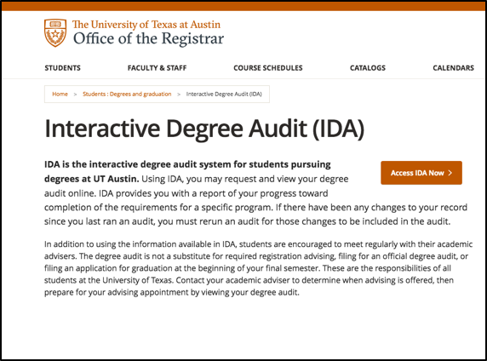
Interactive Degree Audit
Excellent way to see how courses count and what requirements you still have

Slide 19
Registration
Before Registration
Be thinking about which math course you want to take
Have a 1-on-1 meeting with an Academic Advisor (Day 2)
Advisor will provide information about reserved course(s) in your CNS community
Choose 2-3 more courses (for many, UGS 302 or 303 should be one of these)
Have back-up courses in mind
Check your Registration Information Sheet (RIS) for bars
Registration on Day 3
Academic Advisors will be available by email; phone or Zoom as needed
Follow Advisor’s instructions about adding reserved courses first

Slide 20
Registration can be stressful,
but remember:
We are here to help
You will get what you need (not always exactly what you want)
Things change, especially in August:
Use waitlists when you can
Make changes during add & drop periods in August & Sept.
It's the beginning of your UT adventure!

